Slide 1

Digital Ruler

Slide 2

Table of contents
Why have you decided to do this?
What is it?
Can you show me?
Can we get technical?
How customizable is this?

Slide 3
Why have you decided to do this?
Learn to code in Python;
Review eletronics subject;
Get more in to IoT through microcontrollers;
Feed my ambitions in Eletronics and Programming;
Develop an indoor motion sensor light solution.

Slide 4
What is it?
Prototype to apply a distance calculation algorithm;
It has 3 modes: Off, Hold and Active;
Advantages:
Customizable (precision, range and speed of response)
Calculates distance at long ranges
Effective;
Adaptable to integrate other solutions;
Error of distance measurement only around 1cm to 2cm (1-2% of percentage error) for small distances (until 1 meter).
Limitations:
Not portable;
Structure a bit clumsy;
Sensor range limitation (only acceptable between 2cm to 30m);
The higher the distance, the higher the error measurement might be.
Notes:
Prototipo sem

Slide 5
Can you show me?
Live Demo

Slide 6
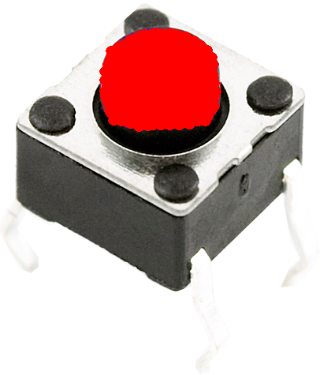
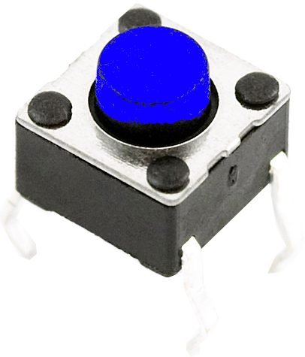
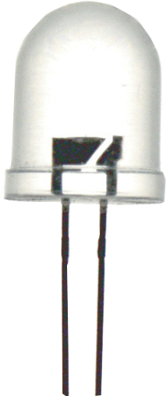
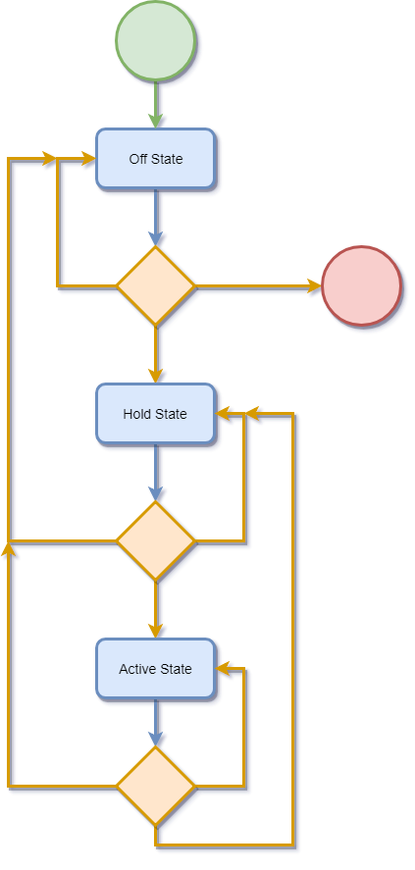

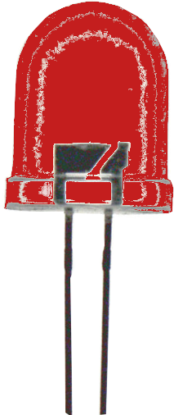
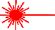
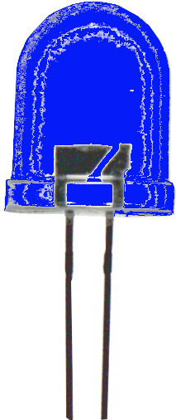
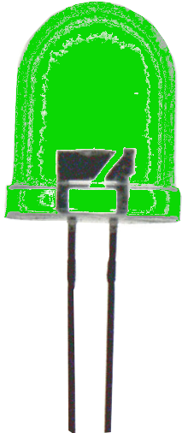
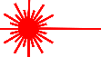
Can we get technical?
State
Input
Endpoint
End button
Flow chart
Mode button
Starting point
*Click*
Action
State
Output
*Click*
Led off
*Click*
Decision
Red Led
*Click*
*Click*
Blue Led
*Click*
Green Led
*Click*
*Click*
Laser
*Click*

Slide 7
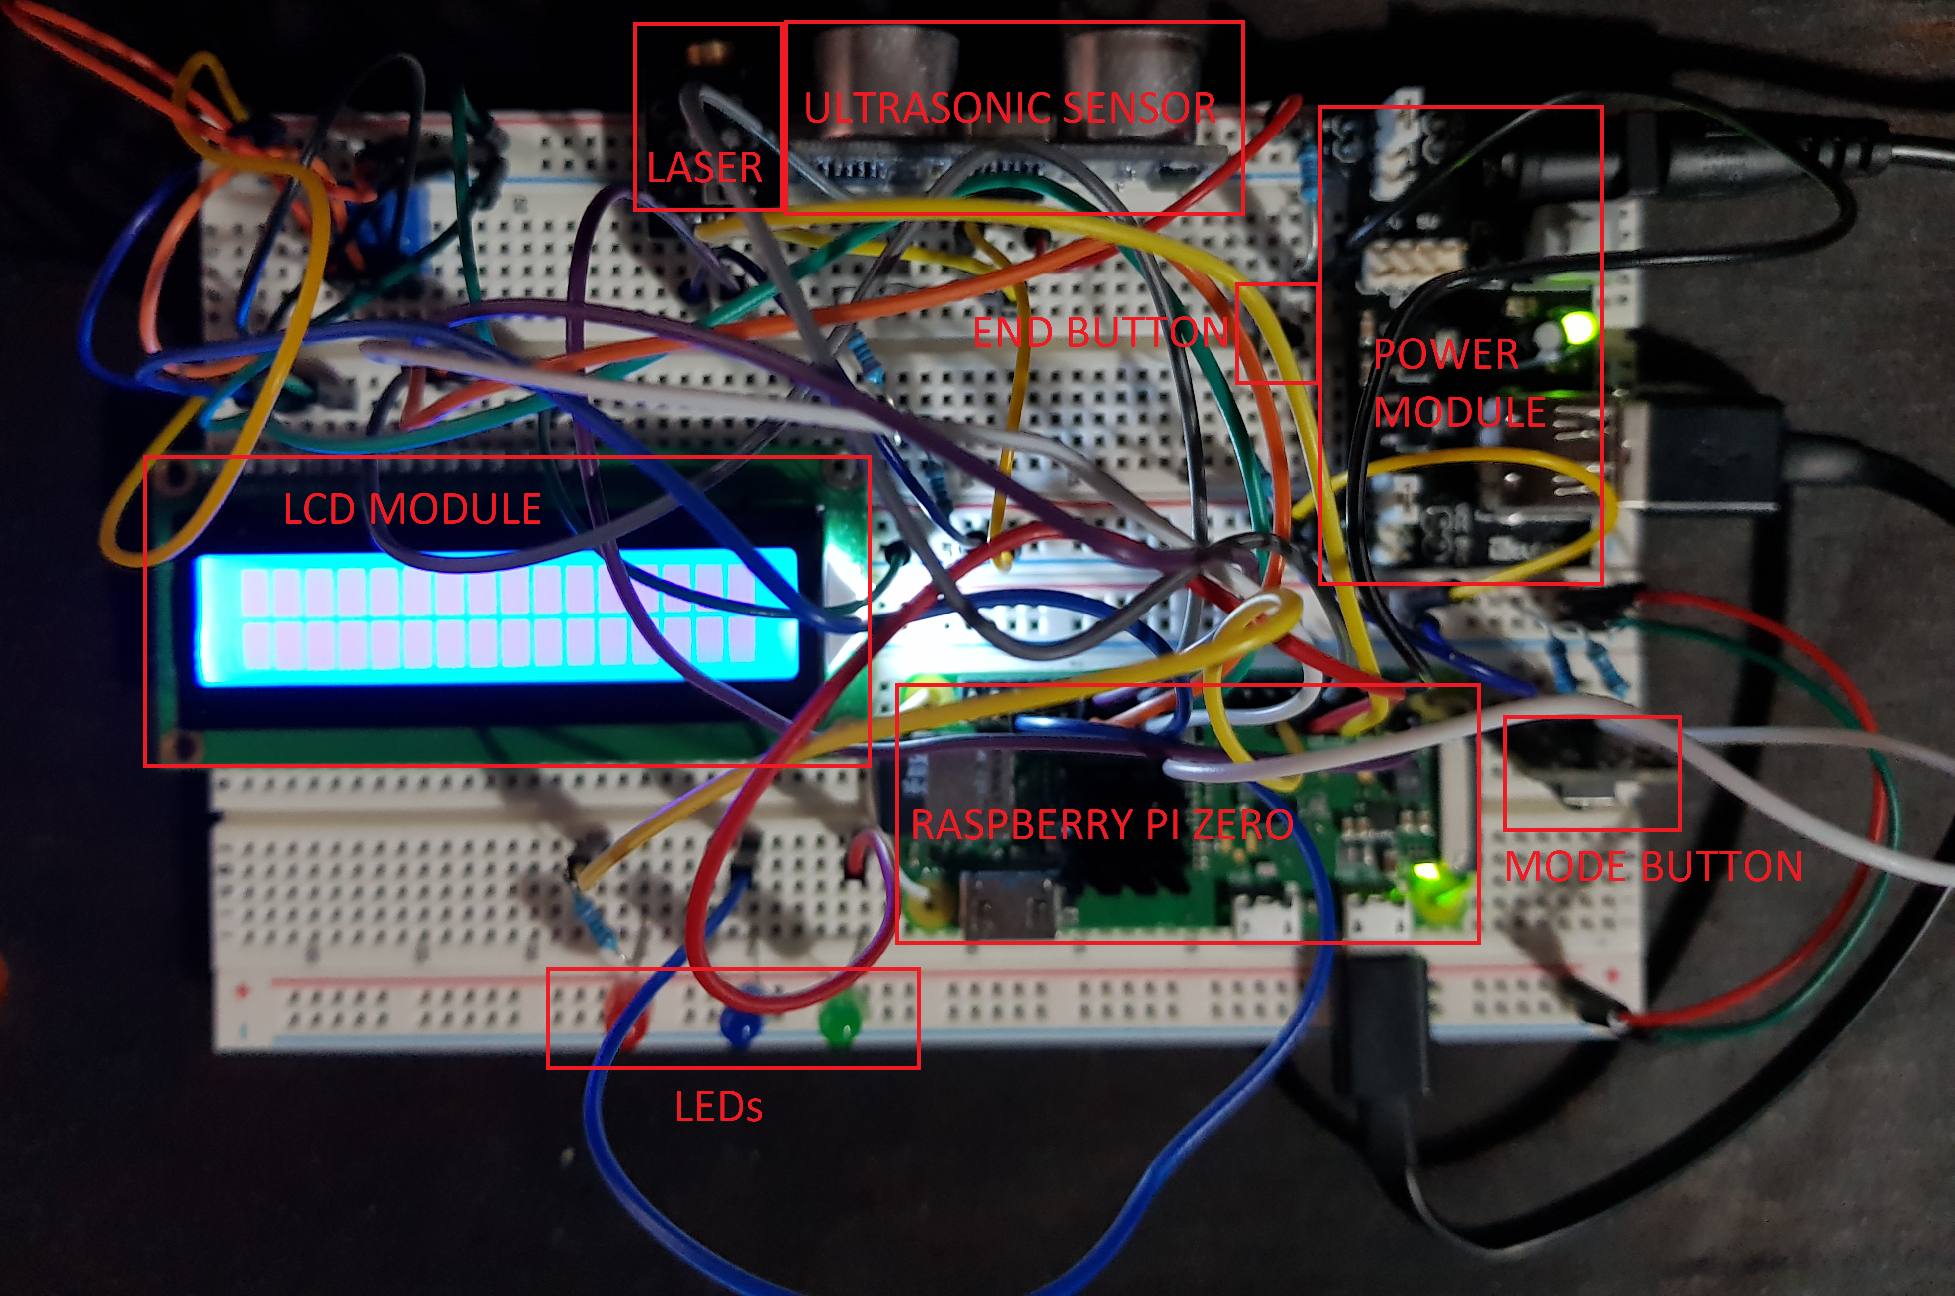
Can we get technical?
Hardware

Slide 8
How customizable is this?
Customizable variables
Size of the Array populated with the distances captured;
Offset that defines a range of distance values that are acceptable to the array;
Maximum range which limits a maximum distance;
Decimal Precision to customize the number of decimal places for the averaged distance value.

Slide 9
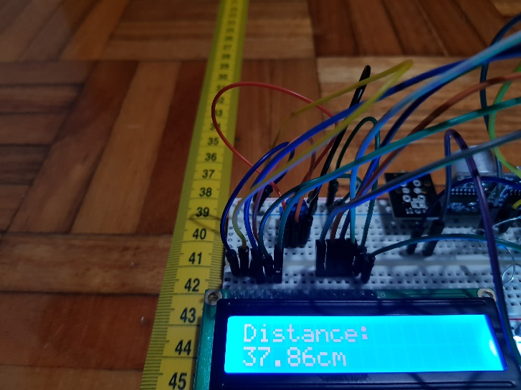
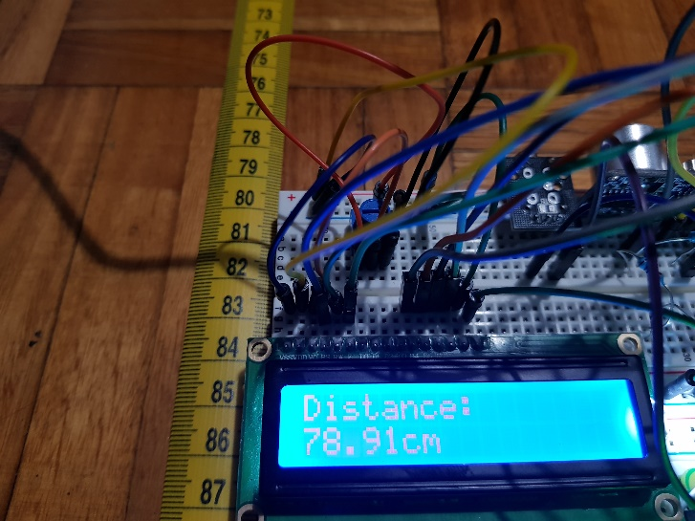
How customizable is this?
Use case
Bad Precision but faster results (Array size = 2 and offset = 4 cm)

Slide 10
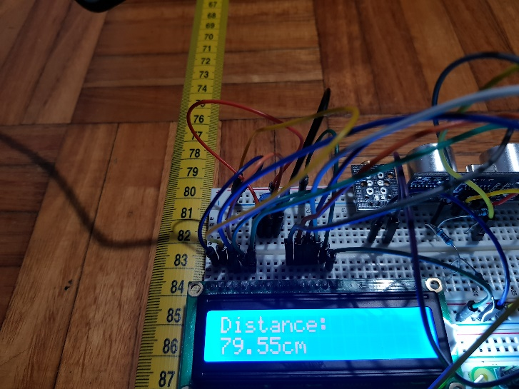
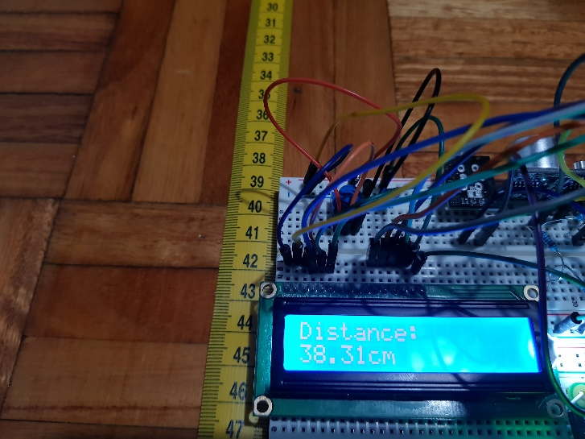
How customizable is this?
Use case
Good Precision but slower results (Array size = 10 and offset = 2 cm)

